Slide 1

3D Slicer 2-Day Workshop
The George Washington University
4/1 & 4/3

Slide 2
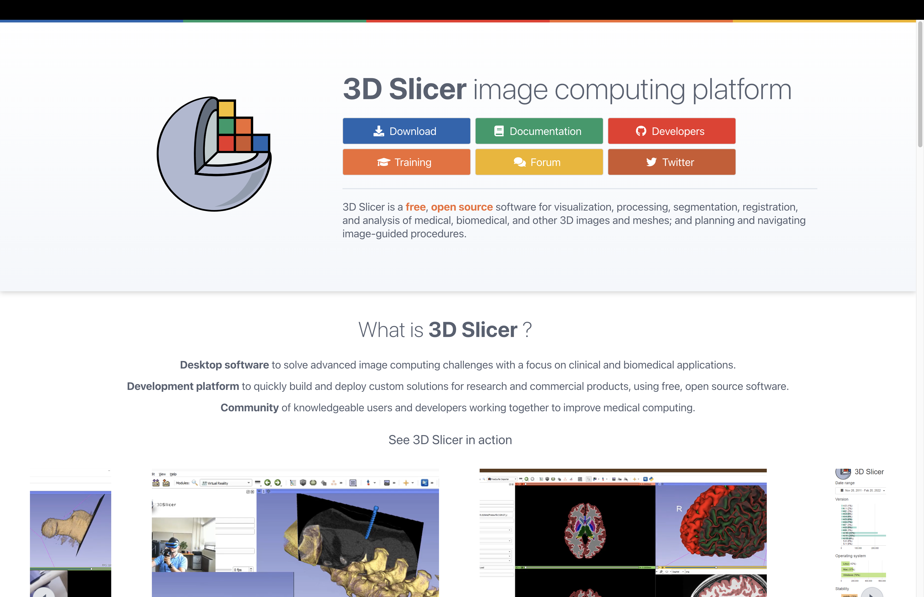

Slide 3
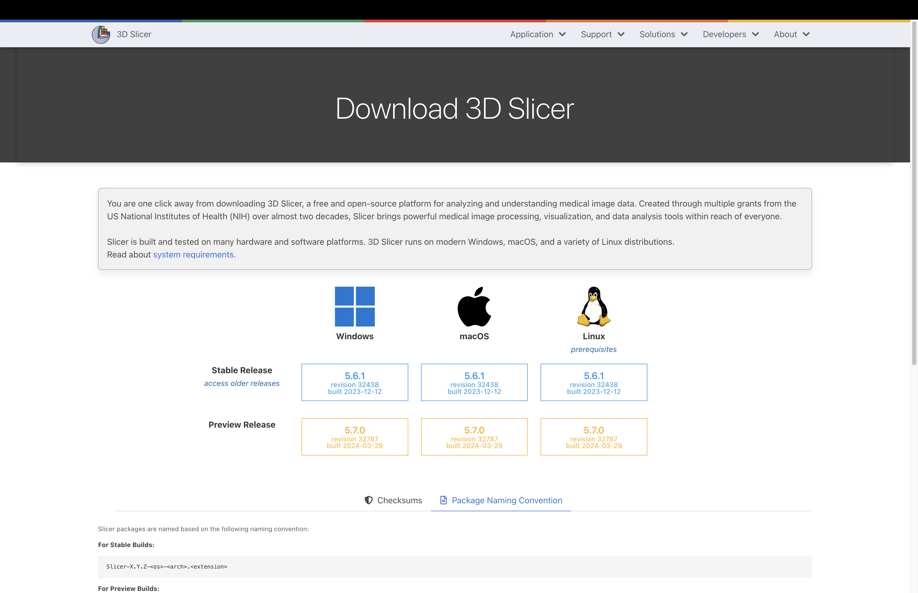

Slide 4
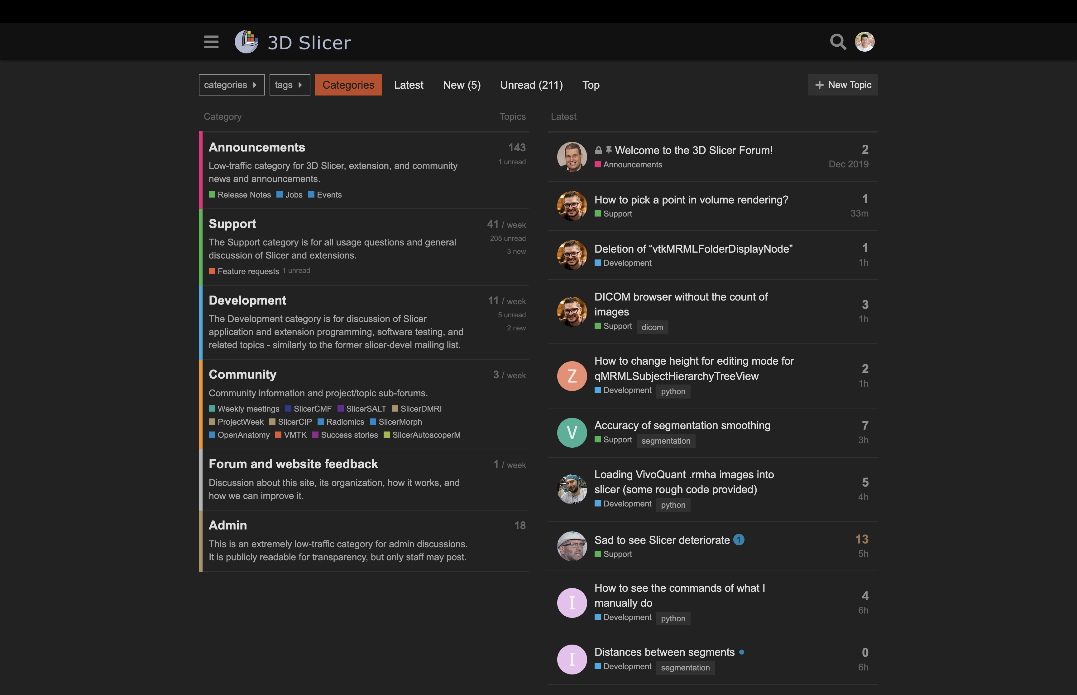

Slide 5
3D Slicer Terminology
Scene – a project repository with a collection of data nodes
Commonly saved as a .mrml or .mrb file
This is the file you load up to resume a saved project
Node – any object or data set loaded into the scene (i.e., volume, segmentation, point list, etc.)
When saving, you save the scene and the individual data nodes
Module – An independent “tool” that provides a set of functions for creating or manipulating data (i.e., Data module, Segment Editor module, Transforms module)
3D Slicer comes with 100+ built-in modules with many more available to download
Extension – A collection of related modules that can be downloaded and installed into 3D Slicer using the Extensions module

Slide 6
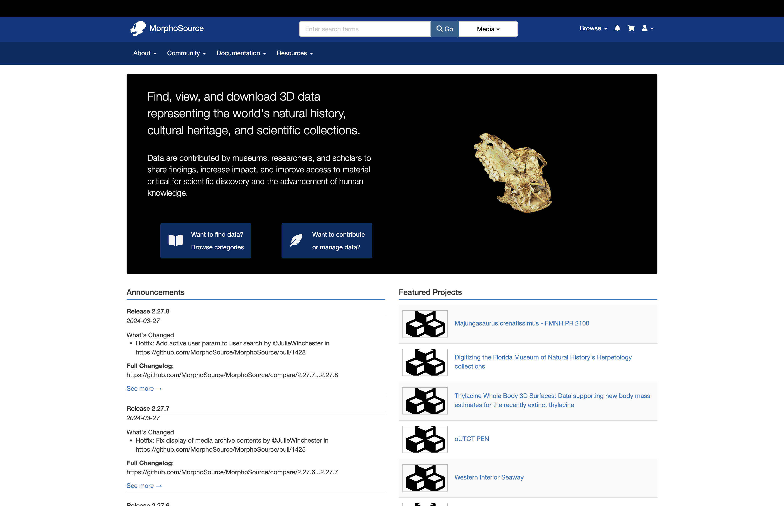

Slide 7
Computed Tomograph (CT) Terminology
CT scanning – a method of combining x-ray imaging and computer technology to generate cross-sectional images of an object
Image Stack – a series of black and white cross-sectional images that contain computed-tomography data
Common formats are standard image formats (.png, .jpg, .bmp, .tif ) or DICOM (.dcm)
Volume Node – image stacks are represented as a scalar volume node
Saved as a .nrrd file
Voxel – a 3D pixel with XYZ dimensions
Image Spacing - the resolution of a CT scan; aka the XYZ dimensions of a voxel
Needed to take accurate measurements from CT scans
Isotropy vs Anisotropy – isotropic data have the same image spacing in the XYZ directions; but when they differ the data is anisotropic
Anisotropy in the Z dimension is common for a lot medical CT scans

Slide 8
Computed Tomograph (CT) Terminology
Volume Rendering – a 3D visualization of the volume node
Presets can be used to attribute grey-scale values with different colors
Can NOT be saved as a 3D model; purely for visualization
Segmenting – the annotation of voxels to delineate structures
Segmentation Node – a data node that contains multiple segments, each of which typically represents a different structure
Can be visualized in 3D, saved as a 3D model, and quantitatively analyzed
Model – a 3D surface representation of an object; in 3D Slicer it’s typically a representation of a segment
Commonly saved as a .ply, .stl, or .obj – these formats are broadly applicable outside of 3D Slicer
Models generated elsewhere can be loaded into Slicer (photogrammetry, CAD models, etc.) but BEWARE resolution

Slide 9
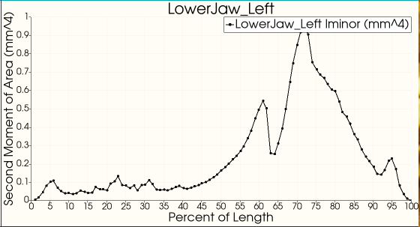
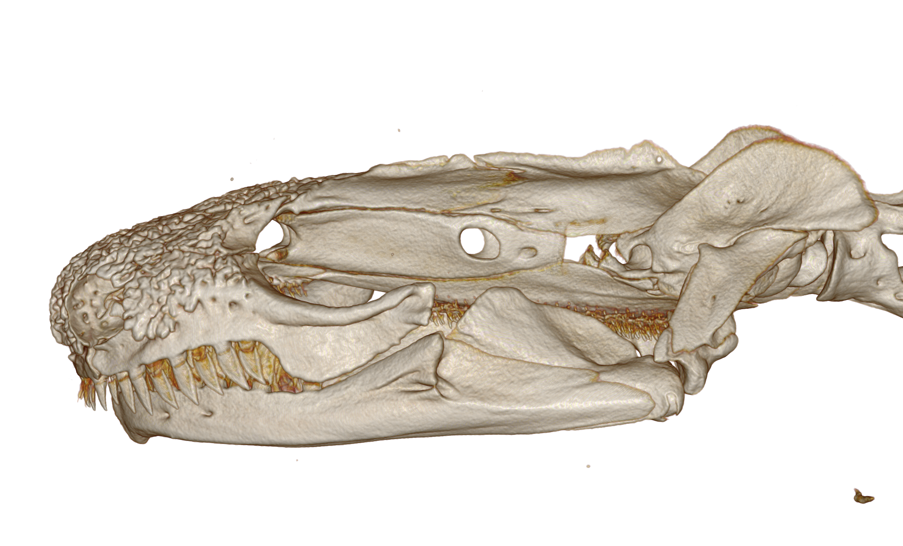

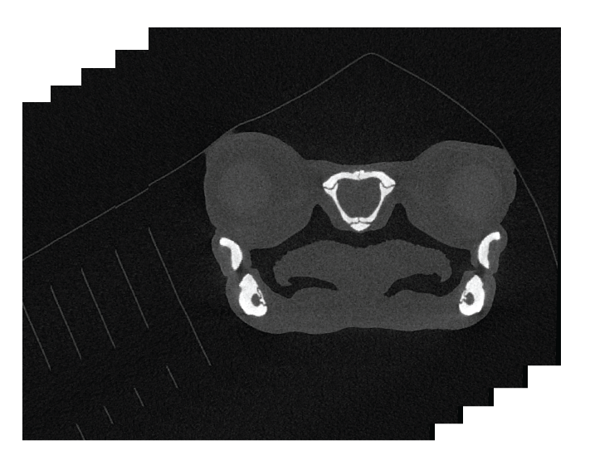
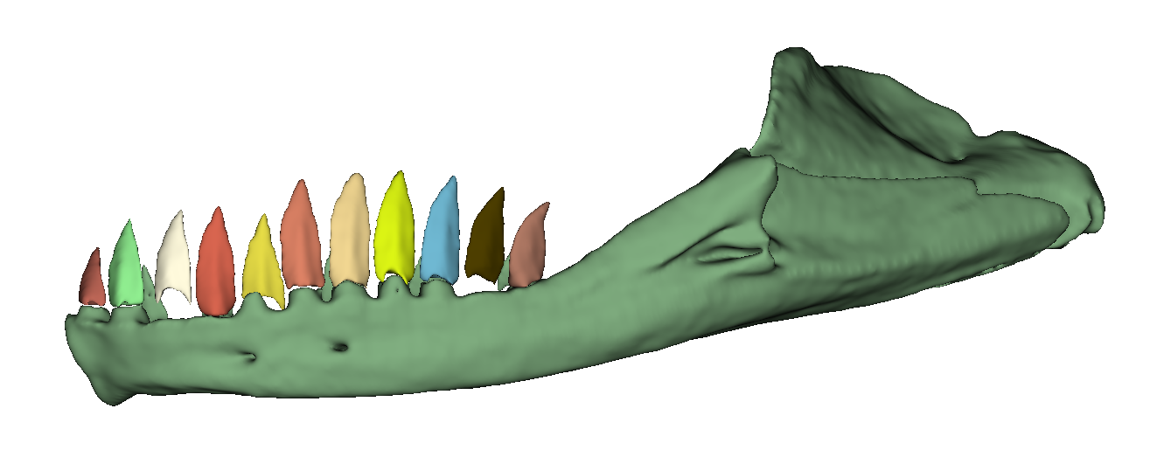

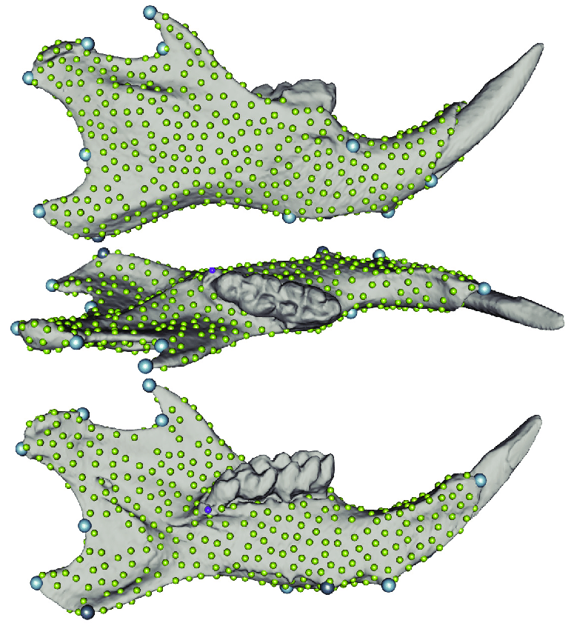
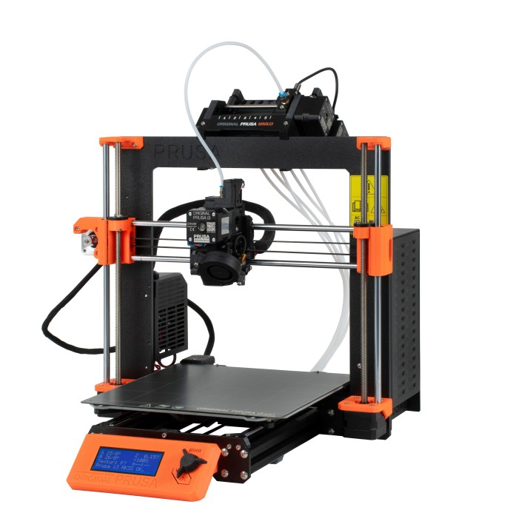
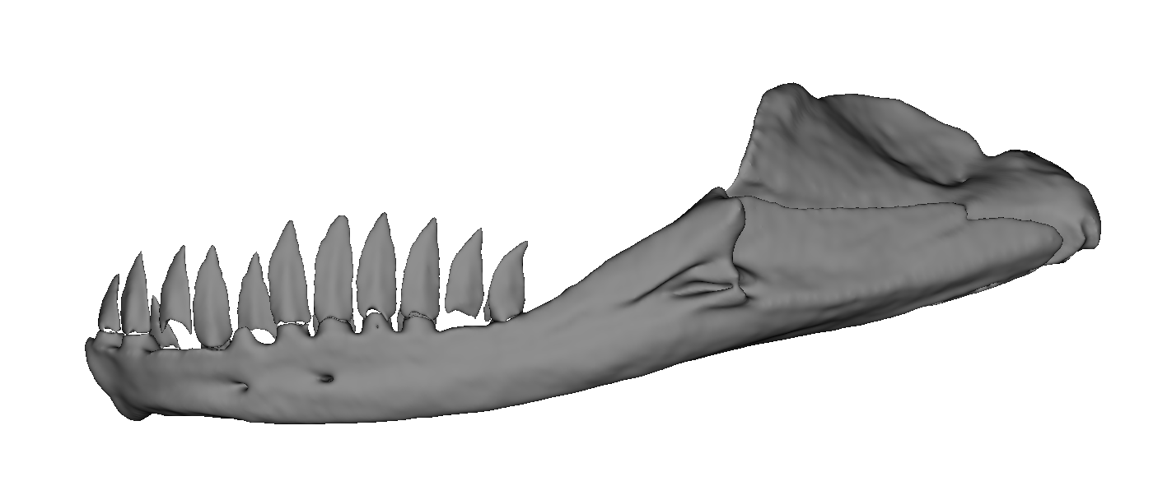
Workflow for computed tomography (CT) data
Analyze
Volume Rendering
Linear Measurements
Markups
Image Stack
3D Slicer
Segment Statistics
Volume Rendering
ImageStacks
Segmenting
Markups
Segment Editor
Segment Statistics
Markups
SlicerMorph;
Markups
Landmarking for GMM
3D Printing
Segmentations;
Data
Export to Model

Slide 10
Resources
Downloading CT Scans
Thousands of free scans on MorphoSource: https://morphosource.org
How to download from MorphoSource: https://youtu.be/SWMketCDtGc?si=rcY9x6ajZ3BxfALv
Getting help with 3D Slicer
3D Slicer Documentation: https://slicer.readthedocs.io/en/latest/index.html
Tutorials by the SlicerMorph team: https://github.com/SlicerMorph/Tutorials/tree/main?tab=readme-ov-file
3D Slicer Discourse Forum: https://discourse.slicer.org/

